Slide 1
Project Title: Online Bookstore Inventory Management System
Presented By:
Mohua Akter (23101057)
Md. Redoan (23101084)
Mariam Alam (23101080)
Presented To:
Alif Ruslan
Lecturer
University of Asia Pacific

Slide 2


Online Bookstore Inventory Management System

Slide 3



Introduction
The project is built to digitally manage and organize an online bookstore.
It includes 7 main tables: Admins, Categories, Books, Customers, Orders, Order_Items, and Reviews.
Each table handles specific tasks such as book records, customer data, orders, and feedback.
The system ensures:
Efficient book and stock management
Order processing and customer tracking
Categorization of books
Admin activity tracking
A relational database design is used to maintain data consistency and integrity.

Slide 4




Entities and Their Attributes:

Slide 5




1. Admins
Admin_id, Name, Email, Phone, Role, Created_at
Primary Key: Admin_id
Foreign Key: None
2. Categories
Category_id, Name, Description, Created_by, Created_at, Status
Primary Key: Category_id
Foreign Key: Created_by → Admins(Admin_id)
3. Books
Book_id, Title, Author, Genre, Price, Stock, Category_id
Primary Key: Book_id
Foreign Key: Category_id → Categories(Category_id)
4. Customers
Customer_id, Name, Email, Phone, Address, Registration_date
Primary Key: Customer_id
Foreign Key: None
5. Orders
Order_id, Customer_id, Order_date, Total_amount, Payment_status, Delivery_status
Primary Key: Order_id
Foreign Key: Customer_id → Customers(Customer_id)
6. Order_Items
Item_id, Order_id, Book_id, Quantity, Price, Subtotal
Primary Key: Item_id
Foreign Keys: Order_id → Orders(Order_id)
Book_id → Books(Book_id)
7. Reviews
Review_id, Book_id, Customer_id, Rating, Comment, Review_date
Primary Key: Review_id
Foreign Keys: Book_id → Books(Book_id)
Customer_id → Customers(Customer_id)

Slide 6


Functional Description of Each Entity:
Admins: Manage category creation and oversee system operations.
Categories: Used to classify books under specific genres or topics.
Books: Store details of available books, linked to categories, used in orders and reviews.
Customers: Registered users who place orders and leave reviews.
Orders: Track purchase activities by customers including payment and delivery statuses.
Order_Items: Hold detailed data of books included in each order (quantities and pricing).
Reviews: Allow customers to rate and review books, helping future buyers.

Slide 7



Relationships Among Tables:
Customers — Places —> Orders
Cardinality: Customer (M) — (M) Order
2. Order_Items — Contains —> Books
Cardinality: Order_Items (M) — (M) Books
3. Customer — Writes —> Review
Cardinality: Customer (1) — (M) Review
4. Reviews — Of —> Books
Cardinality: Book (M) — (M) Review
5. Admins — Create —> Category
Cardinality: Admin (1) — (M) Category
6. Books — Belong_to —> Category
Cardinality: Category (1) — (M) Books
7. Orders — Include —> Order_Items
Cardinality: Orders (M) — (M) Order_Items

Slide 8
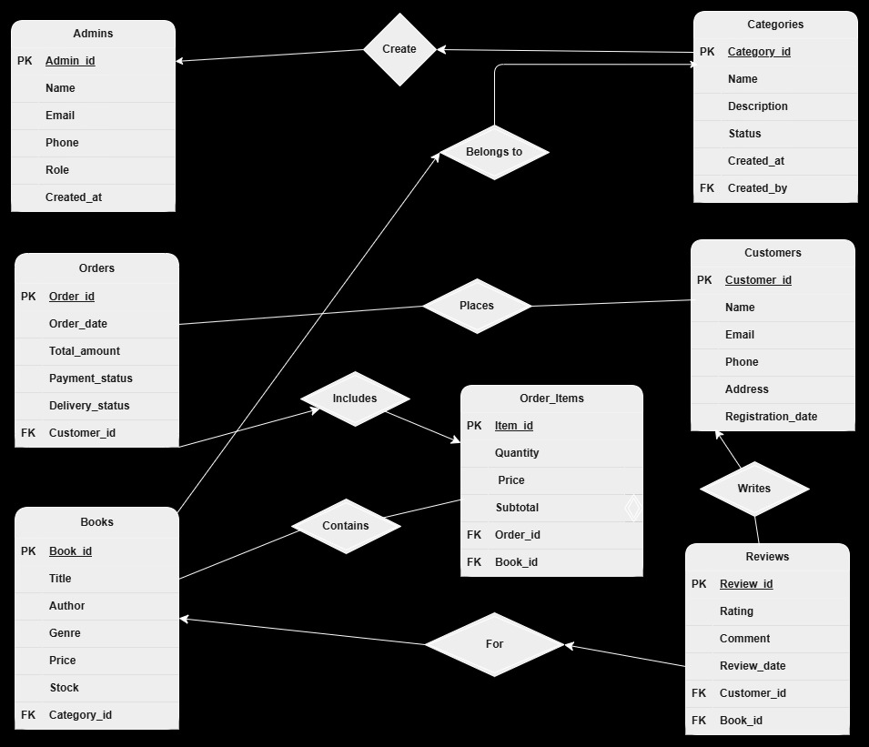



Slide 9
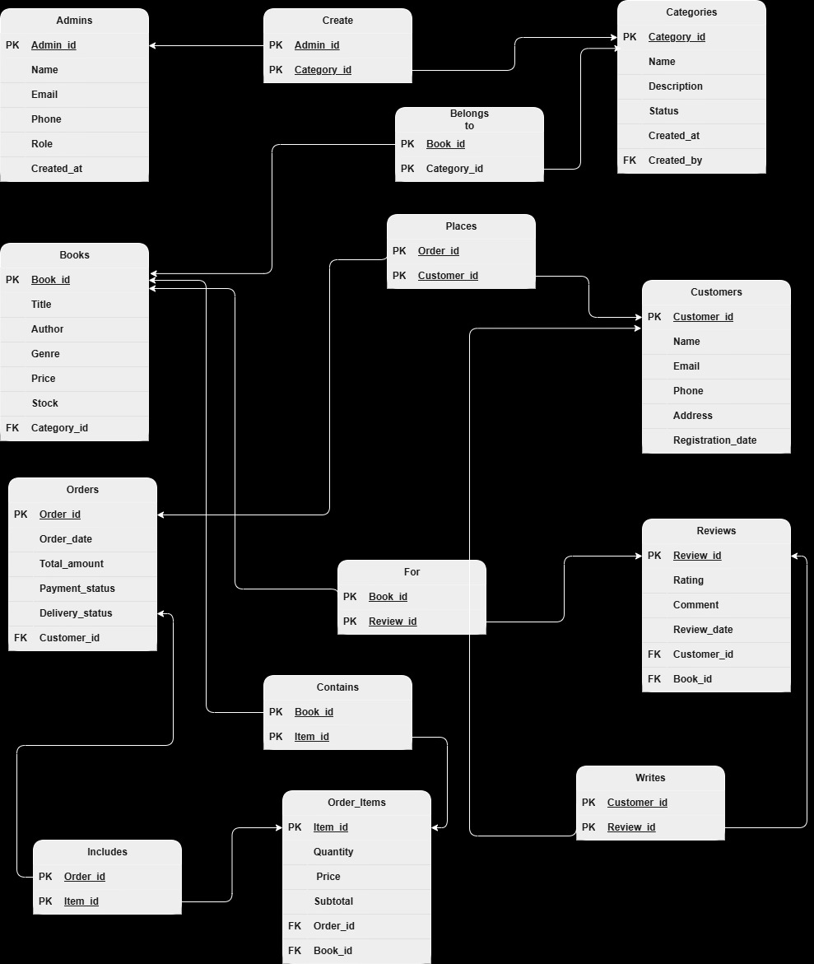



Slide 10
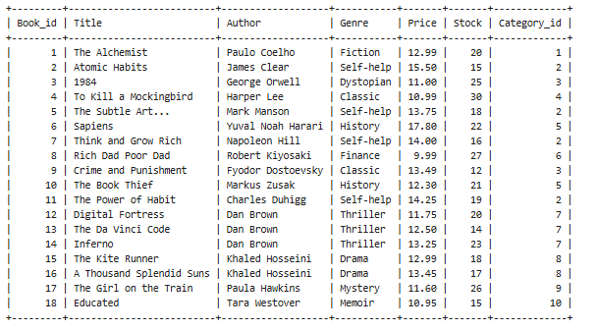
1) SELECT * FROM Books

Slide 11
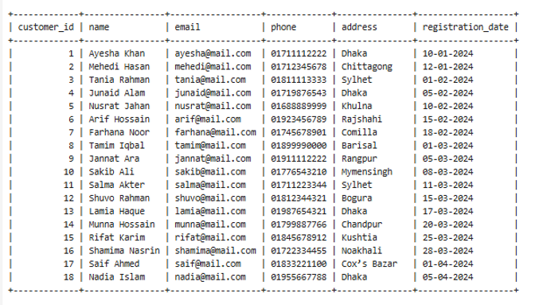
2) SELECT * FROM Customers

Slide 12
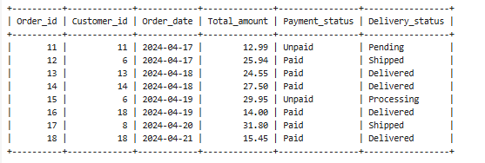
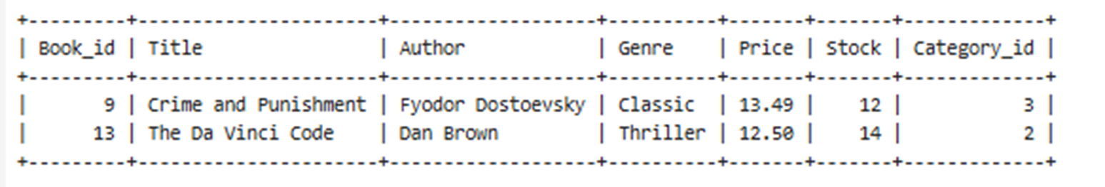
3) SELECT * FROM Orders WHERE order_date BETWEEN '2024-04-17' AND '2024-04-30';
4) SELECT * FROM Books WHERE stock < 15;

Slide 13
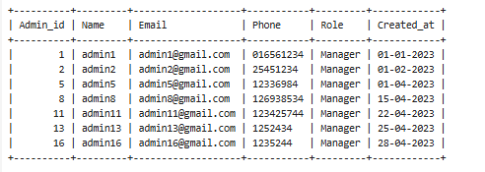
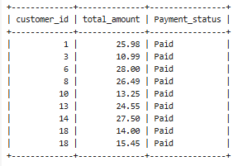
5) SELECT * FROM Admins WHERE role = 'Manager';
6) SELECT customer_id,total_amount,Payment_status FROM Orders WHERE delivery_status = 'Delivered';

Slide 14
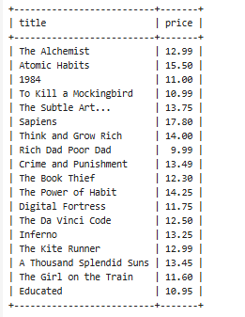
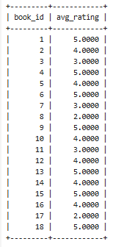
7) SELECT title, price FROM Books;
8) SELECT book_id, AVG(rating) AS avg_rating FROM Reviews GROUP BY book_id;

Slide 15
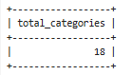
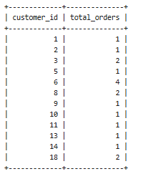
9) SELECT COUNT(*) AS total_categories FROM Categories;
10) SELECT customer_id, COUNT(*) AS total_orders FROM Orders GROUP BY customer_id;

Slide 16
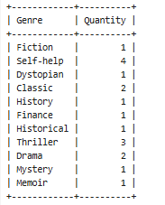
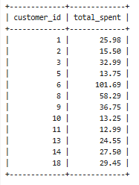
11) SELECT Genre , count(Genre) as Quantity from Books GROUP BY(Genre);
12) SELECT customer_id, SUM(total_amount) AS total_spent FROM Orders GROUP BY customer_id ;

Slide 17
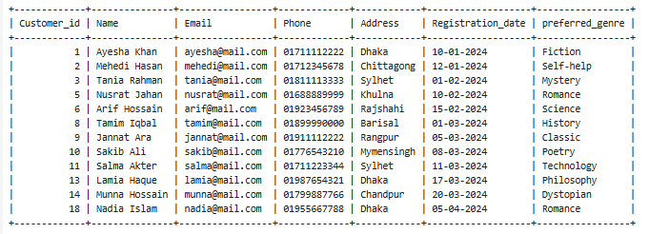
13) SELECT * FROM Customers WHERE customer_id IN (SELECT customer_id FROM Orders);

Slide 18
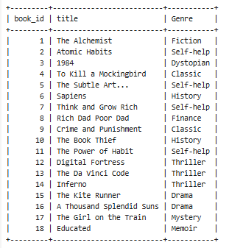
14) SELECT book_id,title,Genre FROM Books WHERE book_id IN (SELECT book_id FROM Reviews);

Slide 19
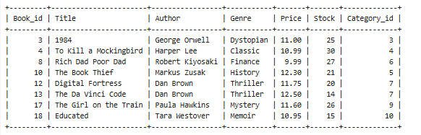
15) SELECT * FROM Books WHERE price < (SELECT AVG(price) FROM Books);

Slide 20
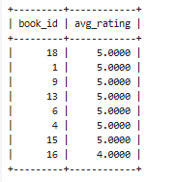
16) SELECT book_id, AVG(rating) AS avg_rating
FROM Reviews
GROUP BY book_id
ORDER BY avg_rating DESC
LIMIT 8;

Slide 21
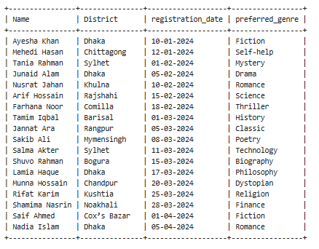
17)
ALTER TABLE Customers
ADD column preferred_genre VARCHAR(50);
UPDATE Customers SET preferred_genre = 'Fiction' WHERE customer_id = 1;
UPDATE Customers SET preferred_genre = 'Self-help' WHERE customer_id = 2;
UPDATE Customers SET preferred_genre = 'Mystery' WHERE customer_id = 3;
UPDATE Customers SET preferred_genre = 'Drama' WHERE customer_id = 4;
UPDATE Customers SET preferred_genre = 'Romance' WHERE customer_id = 5;
UPDATE Customers SET preferred_genre = 'Science' WHERE customer_id = 6;
UPDATE Customers SET preferred_genre = 'Thriller' WHERE customer_id = 7;
UPDATE Customers SET preferred_genre = 'History' WHERE customer_id = 8;
UPDATE Customers SET preferred_genre = 'Classic' WHERE customer_id = 9;
UPDATE Customers SET preferred_genre = 'Poetry' WHERE customer_id = 10;
UPDATE Customers SET preferred_genre = 'Technology' WHERE customer_id = 11;
UPDATE Customers SET preferred_genre = 'Biography' WHERE customer_id = 12;
UPDATE Customers SET preferred_genre = 'Philosophy' WHERE customer_id = 13;
UPDATE Customers SET preferred_genre = 'Dystopian' WHERE customer_id = 14;
UPDATE Customers SET preferred_genre = 'Religion' WHERE customer_id = 15;
UPDATE Customers SET preferred_genre = 'Finance' WHERE customer_id = 16;
UPDATE Customers SET preferred_genre = 'Fiction' WHERE customer_id = 17;
UPDATE Customers SET preferred_genre = 'Romance' WHERE customer_id = 18;
SELECT Name, Address as District, registration_date, preferred_genre FROM Customers;

Slide 22
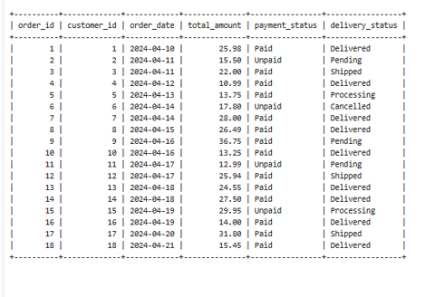
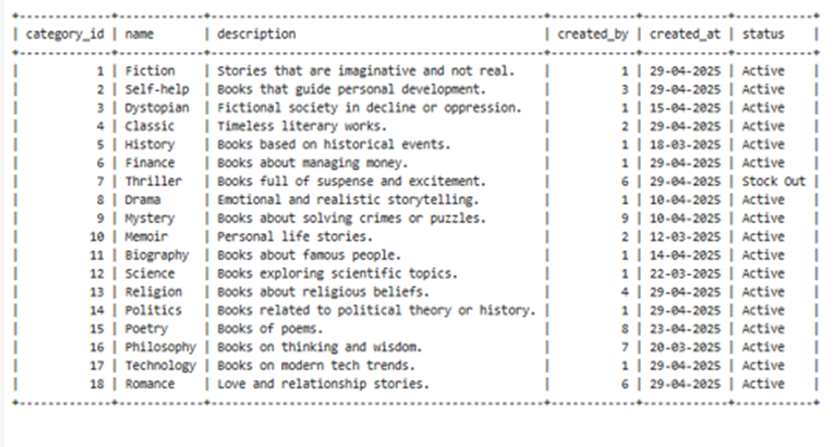
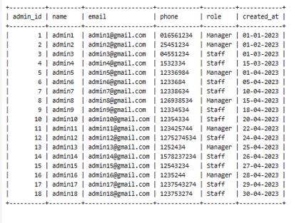
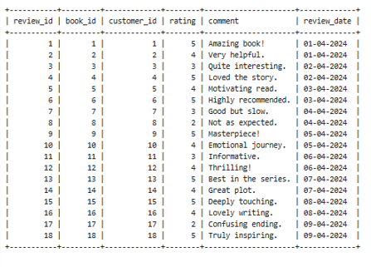
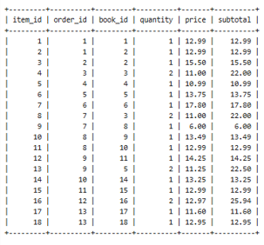

Slide 23





Conclusion:
The Online Bookstore Inventory Management System enables efficient digital handling of bookstore operations, including inventory management, customer transactions, book categorization, and review collection. This database design enhances productivity, ensures accuracy, and simplifies the tracking of every component of the bookstore. Such systems are essential in modern e-commerce platforms to maintain consistency and provide a better user experience.

Slide 24




Thank You

